Slide 1
Final Presentation
Database Management Systems

Slide 2
Introduction
Team 6: Charles Howard, Eva Haishun, Alex Scalamandre, Christopher Blazak
Case Analysis:
Computer Security Incident Response Teams should be able to track incidents;
Each incident is recorded in a database;
Incident responders must be able to query the database by incident number and receive a report containing the full history of a given incident;
Incident tracking system must be able to export each incident;
All updates to an incident must be recorded as free-form comments to the incident.

Slide 3
Schema Design with PK, FK
Tables with Primary and Foreign Keys:
INCIDENT(incidentID, type, state, date)
IP(IPAddress, incidentID)
PERSON(personID, firstName, lastName, emailAddress, jobTitle, incidentID)
COMMENTS(commentID, comment, name, date, incidentID)

Slide 4
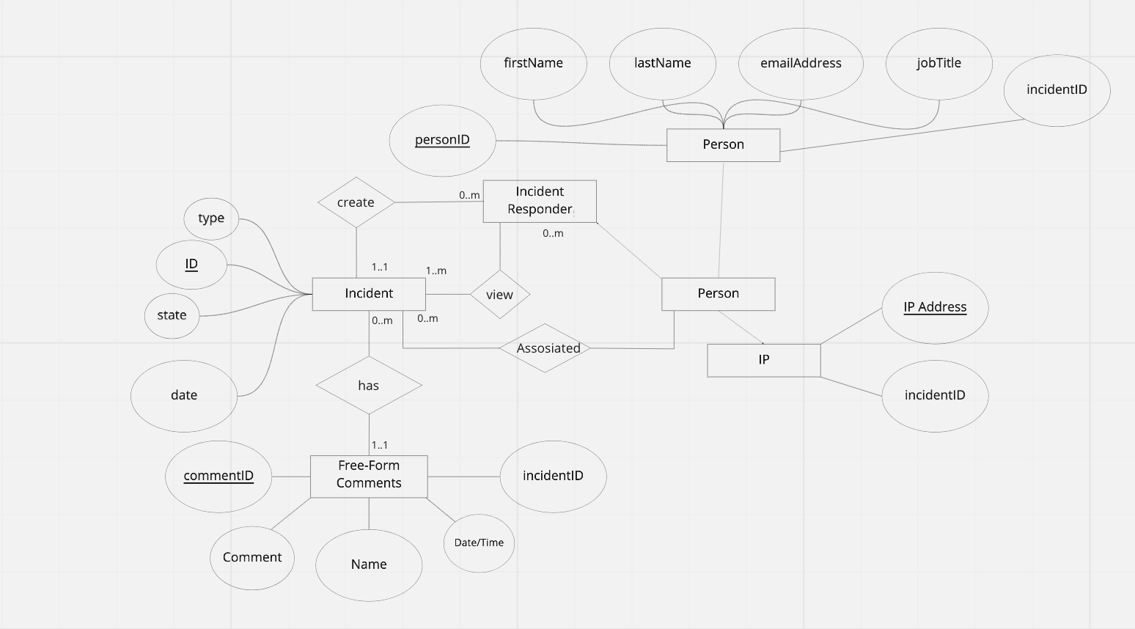
Entity-Relationship Model

Slide 5
Entity-Relationship Model
Entities: Person, Incident Responder, Free-Form Comments, Incident, IP
Attributes:
Person: personID, firstName, lastName, emailAddress, jobTitle, incidentD.
Incident: type, ID, state, date.
Free-Form Comments: commentID, Comment, Name, Date/Time, incidentID.
IP: IP Address, incidentID.
Cardinality:
One-to-One cardinality (1:1): Free-Form Comments to Incident; Incident to Incident Responder.
One-to-Many cardinality (1:n): Incident to Incident Responder.
Many-to-Many cardinality: Incident Responder to Incident; Incident Responder to Person; Incident to Free-Form Comments.

Slide 6
Entity-Relationship Model
Degrees:
Binary relationship of degree two: Free-Form Comments and Incident; Incident and Incident Responder; Incident Responder and Person; Person and Incident; Person and Person; Person and IP.

Slide 7
Normalization 1NF
Person
personID
firstName
lastName
emailAddress
jobTitle
incidentID
IP
comments
In the First Normal Form (1NF) each attribute has unique identifier, Primary Key.
To normalize the UNF for the 1NF, it is necessary to separate all the entities.
In this form, the information is not collected in a single attribute.

Slide 8
Normalization 2NF
In the Second Normal Form (2NF) every non-prime attribute is dependent on the primary key.
As the incidents can be listened multiple times, it could potentially lead to duplicate data.
IncidentID (Primary Key) will reference back to the new table.
Person
personID
firstName
lastName
emailAddress
jobTitle
IncidentID
IP
comments
Incident
IncidentID
Type
State
Date

Slide 9
Normalization 3NF
Person
personID
firstName
lastName
emailAddress
jobTitle
IncidentID
IP
CommentID
Incident
IncidentID
Type
State
Date
Comments
CommentID
Name
Date/Time
Comment
incidentID
In the Third Normal Form (3NF) attributes are determined only by the primary key.
Primary key CommentID will reference back to the new Comments table.

Slide 10
Normalization Boyce-Code Normal Form
Person
personID
firstName
lastName
emailAddress
jobTitle
IncidentID
IP
CommentID
Incident
IncidentID
Type
State
Date
Comments
CommentID
Name
Date/Time
Comment
IncidentID
BCNF is a stronger version of the third Normal Form.
The remaining attributes are separated.
Comment
Reason

